Slide 1
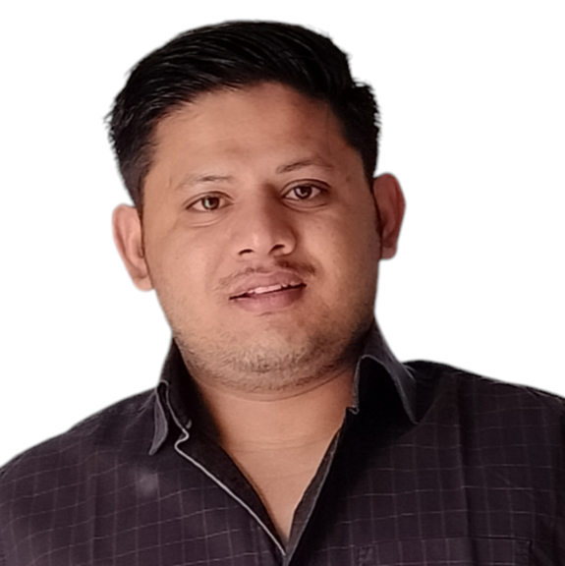

Professional Background
Project Highlights (Representative)
Professional Experience: Over 5 years in Power Platform & Quick Process Automation.
Proficient in Microsoft Power Platform and cloud technologies.
Designed scalable Power Apps solutions integrated with Dataverse and SharePoint Online, Optimizing workflows and backend systems for enhanced data performance and reliability.
Data-Driven Decision Making: Created insightful dashboards with Power BI, enabling stakeholders to make informed decisions based on real-time data analysis and reporting.
Projects on Power Platform -
Customer Master Data : Developed process automation in healthcare sector initiatives using Power Automate, eliminating manual tasks and significantly improving operational efficiency. My experience includes designing and implementing Power Apps solutions, integrating Dataverse and SharePoint Online to create scalable workflows and optimized backend system. Create and manage automated processes using Power Apps, Power Automate, Power BI , Power Query , Power Automate Desktop , Excel VBA, Azure Portal.
Played a role of lead Developer and Business Analyst for requirement gathering with business stakeholders and developing mobile applications.
SmartNet Inwards and Outwards : Digitalized the processes using Power Platform enabled rapid development and integration of functionalities. We built an innovative suite of dashboard that covered the entire lifecycle of a well from the ideation stage to well retirement. Various processes were unified under one system while accommodating exceptions. Canvas apps applications were developed for data management for mobile data updates, and Power BI for reporting. Different data sources were connected using Dataverse and SharePoint Folder and SharePoint list.
Acted as the Project Lead and Senior PowerApps Developer. My responsibilities included gathering requirements from business stakeholders, providing cost-effective solutions using Power Platform, developing PowerApps applications, Power BI reports & ETL by Power Queries with dynamic functions (M-Language), ensuring quality and compliance, conducting application testing and production deployment, and coordinating offshore-onshore activities.
Delivered functionalities in weeks, reducing development time & maintenance overhead. 10+ applications were developed within a year.
Projects On SharePoint
Evaluated process automation requirements and design Automation solutions for the business operations delivering exponential efficiency and effectiveness. Worked and developed over 40+ Solutions for the multiple automation requirements presented by the client. Provided insights on multiple dashboards for Data Analysis through Power BI.
SURENDRA KUMAR
Power Platform Solution Developer
Core Competencies
Technical Skills : Power BI, Power Apps, Power Automate SharePoint, VBA, Power Query, Dataverse
Technical Secondary Skills : Python, Web Scraping
Process Skills :
Automation, Governance
Education
Bachelor of Computer Application Makhan Lal Chaturvedi National University - Bhopal
Hyderabad, India

